Slide 1
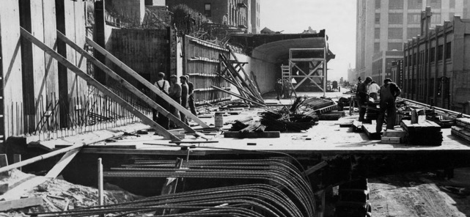
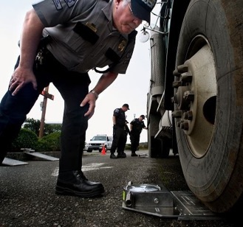
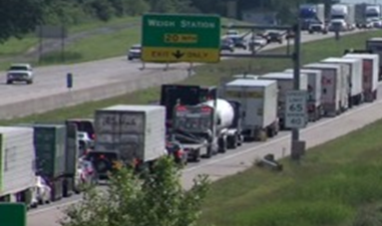
Section 2.25 Weigh-In-Motion Used for Vehicle Enforcement – Proposal to Amend
WWMA Annual Meeting

Slide 2
Agenda
1. Objective/Current State
2. Proof is in the pudding
3. Proposed changes

Slide 3
1. Objective/Current State
Weigh-In-Motion Used for Vehicle Enforcement
Objective
There is a growing need in the commercial vehicle weight enforcement to provide an automated way to enforce weight limits to protect infrastructure, ensure truck safety, address limited law enforcement resources, and to be prepared for new technologies in trucking (autonomous trucks).
Vehicle WIM for weight enforcement has been proven at high and low speeds for 20+ years and led to HB44 section 2.25 being added. Since then, technology has improved and testing results have led to the proposed changes. Automated weight enforcement benefits taxpayers, legally operating trucking companies, law enforcement, the motoring public and society in general.
Progress to Date
Countries around the world have introduced automated weight enforcement since 2004 (China, Czech Republic, Russia, Hungary, France, Brazil). Infrastructure protection and enforcement efficiency advantage.
States have been using ASTM E1318 Type III for around 20 years as a standard for vehicle enforcement screening with slightly wider tolerances
Maryland SHA has managed an 18 site Virtual Weigh Station network since 2009 exceeding proposed improvements in areas where weigh stations aren’t feasible
NYCDOT/C2SMART/Rutgers have been working on the Brooklyn-Queens Expressway (BQE) since 2019 to test weight accuracies, drive NYC legislation for ticketing OW violators, and establish submitted changes to protect this critical piece of infrastructure

Slide 4
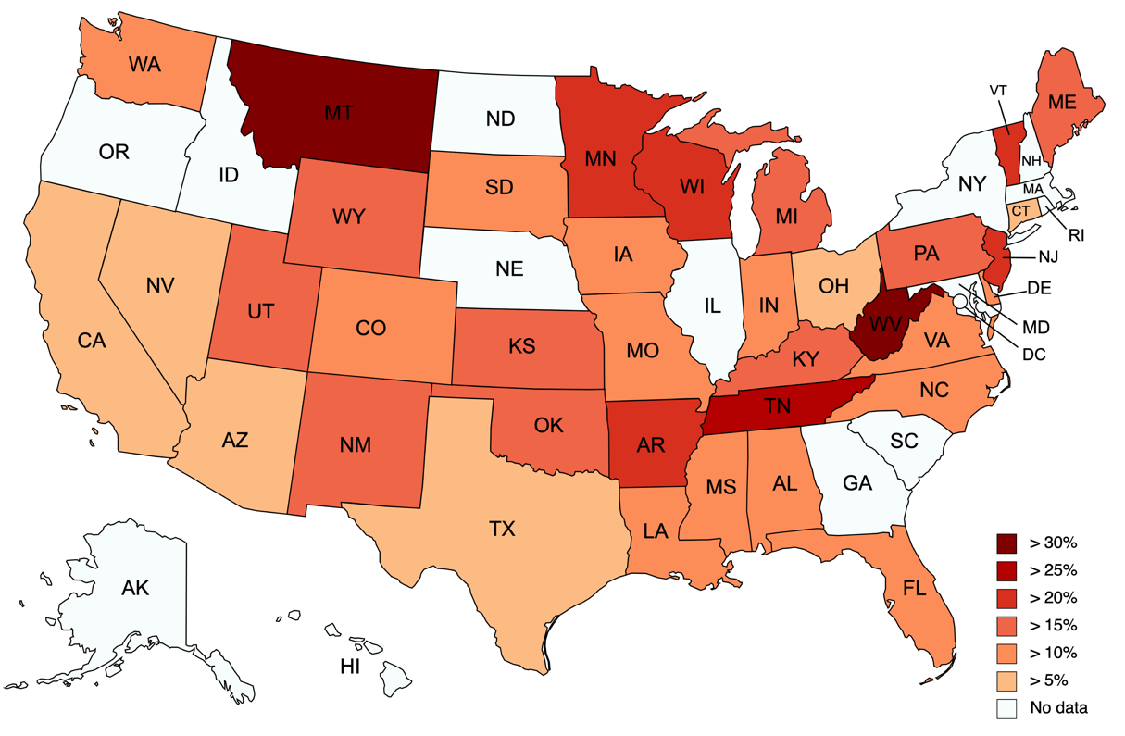
Review of Overweight Percentages across the Nation
Per LTPP WIM data, the national average overweight percentage would be 13.21%.
New Jersey: Only 6.4% of OW trucks were identified at the stationary weighing stations across the entire states (compared to all the WIM stations).
New York City: Only 14.6% of OW trucks were identified by the police along BQE corridor (compared to WIM station at BQE)
Impossible to improve enforcement without updated WIM standards!
Need ubiquitous and effective OW Truck enforcement…

Slide 5
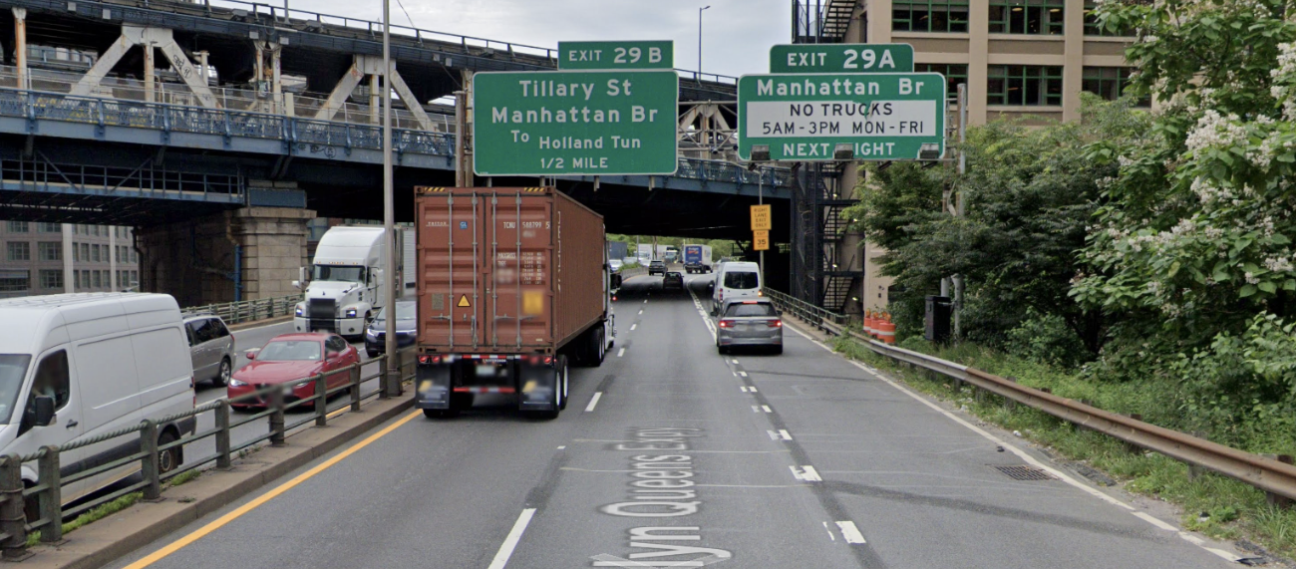
2. Proof is in the pudding
WIM Testing Results 1 – NYCDOT BQE
Standards |  | GVW | Sgl | Tan
Calibration (10/17/2020) - Trucks: C9, C9S, C6, C5ª, C5^{b} | No. of Test | 30 | 30 | 42
 | Max Error (%) | 4.4 | 12.4 | 8.0
 | Compliance (%) | 100 | 100 | 100
RE-Calibration (12/07/2021) - Trucks: C9, C7 | No. of Test | 6 | 6 | 9
 | Max Error (%) | 4.7 | 5.8 | 9.6
 | Compliance (%) | 100 | 100 | 100
ASTM E1318 Type III | Target Accuracy at 95% Compliance | 6% | 15% | 10%
Four (4) Quartz sensors were installed in the center lane of the BQE Corridor in 2019.
Quartz sensors were able to comply with accuracy requirements for all standards (ASTM, OIML, COST).
The max. error for GVW is 4.4% which meets the max. tolerance of 6%. The single axle and tandem axle meet the tolerance of 15% and 10%, respectively.
Accuracy varies depending on truck speed. However, the speed variance could be eliminated by the optimization process.
Although the site included severe rutting, Quartz sensors met the accuracy and compliance for ASTM E1318 Type III.
Routine calibration is highly recommended every 6 or 12 months.
High Accuracy is Achievable Now!
(Notes for the Table) C = FHWA Classification, e.g., C9 = Class 9, C9S = Class 9 Split Tandem, C5ª= bigger Class 5, C5^{b}= smaller Class 5

Slide 6
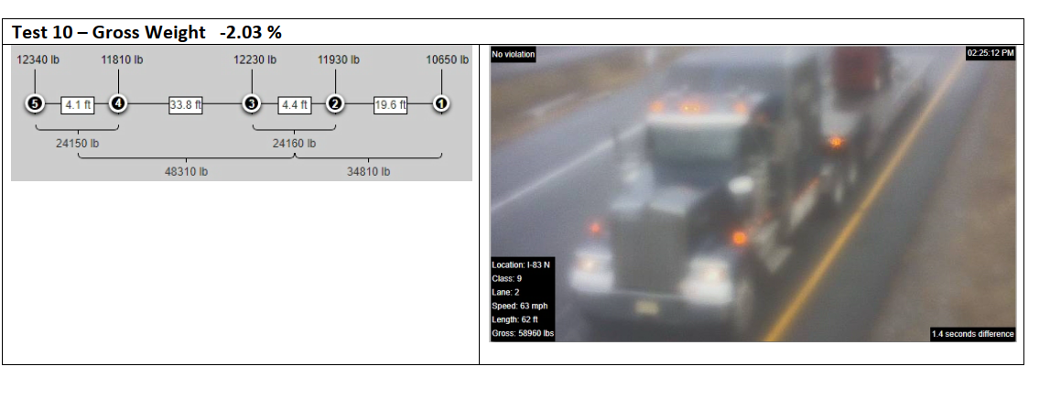
WIM Testing Results 2 - Maryland
18 Sites Tested Every 6 months for last 8 years
US-50E
Run | Speed (mph) | Measured GVW (kips) | Target GVW (kips) | Error
1 | 51.4 | 68,720 | 69,140 | -0.61%
2 | 57.8 | 67,090 | 69,140 | -2.96%
3 | 60.4 | 66,420 | 69,140 | -3.93%
4 | 57.6 | 67,160 | 69,140 | -2.86%
5 | 62 | 68,450 | 69,140 | -1.00%
Max Error = 3.93% < 6%
= 100% Compliance
I-695S
Run | Speed (mph) | Measured GVW (kips) | Target GVW (kips) | Error
1 | 56.5 | 75,710 | 75,920 | -0.28%
2 | 53.5 | 78,140 | 75,920 | 2.92%
3 | 57.4 | 76,940 | 75,920 | 1.34%
4 | 46.9 | 78,800 | 75,920 | 3.79%
5 | 55.9 | 76,040 | 75,920 | 0.16%
100% Compliance with Form 15 submittal!

Slide 7
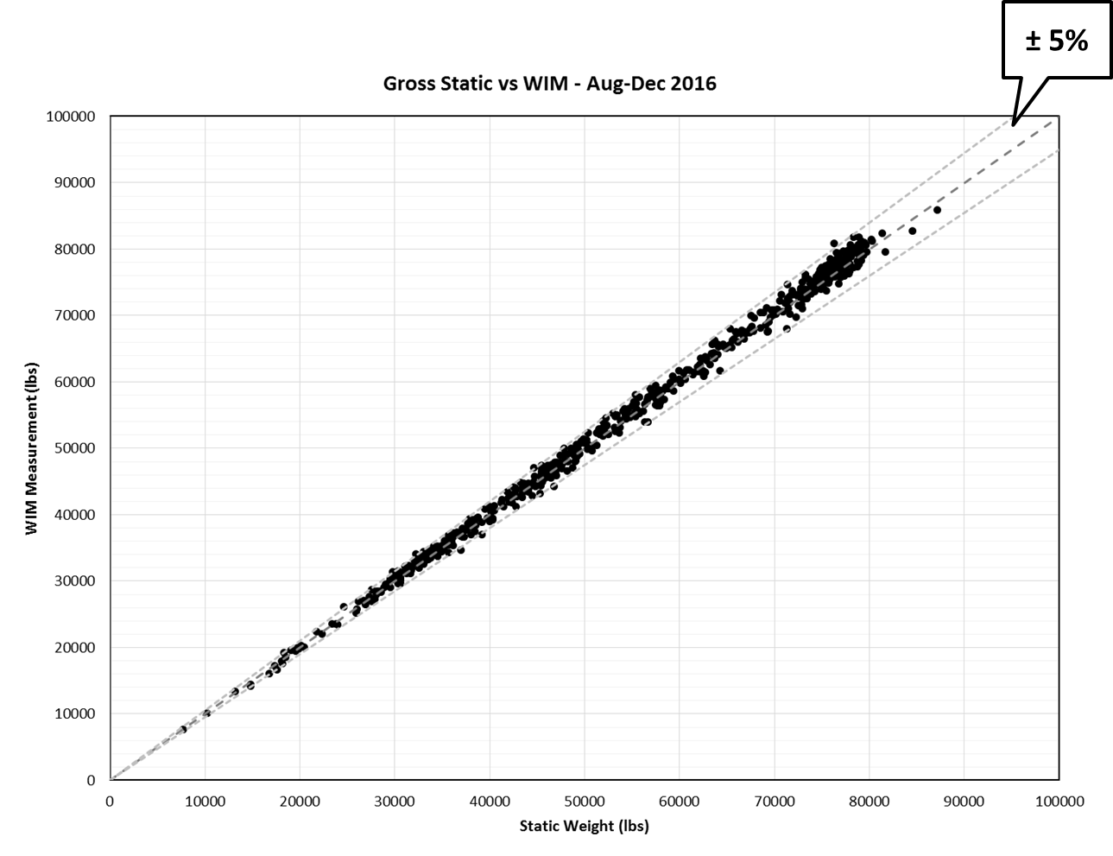
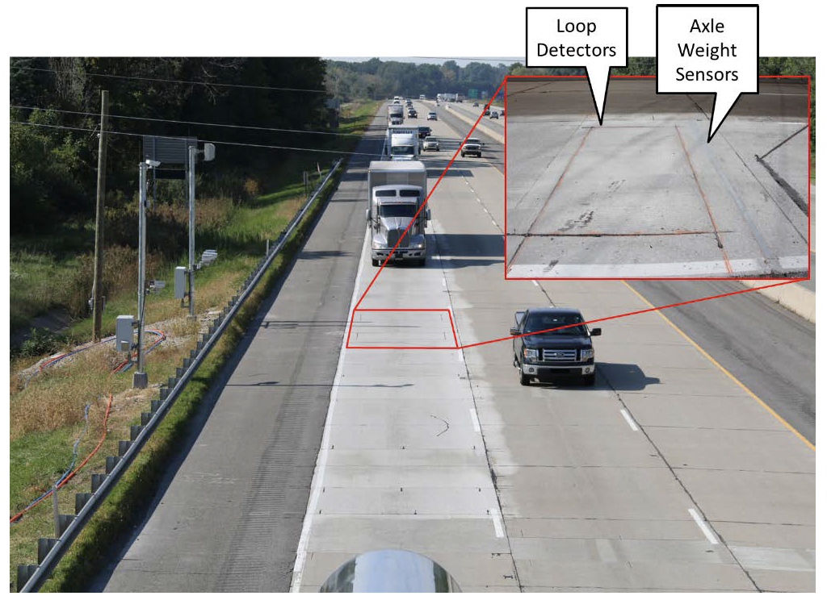
WIM Testing Results 3 - Indiana
Indiana DOT Pilot Project
Started 2016 by INDOT and KAPSCH at I-94 Chesterton Weigh Station:
Vehicles identified at WIM (Quartz)
and static weigh station
(Taken from Report by Purdue University)
Within 5% is achievable– Technology is now Better!
Photo by Wayne Bunnell, Purdue University

Slide 8
3. NIST HB44 Section 2.25 Proposed Changes
Key Elements
How many States actually used tentative code? – No impact in changing
Change from current “tentative screening code” to “permanent enforcement code”
Update test procedures using 3 trucks and 3 loading cases, matching Single Draft Weigh-in-Motion
Class 9, Class 6 and Class 5 with fully loaded, half loaded, and empty in addition to 3 speeds
Minimum of 60 runs (20 per vehicle type)
Tighten tolerances to ensure fairness and to stand-up in court
GVW 6%, Axle Group 10%, and Axle 15% errors at 95% compliance.
GVW 10% error at 100% compliance.

Slide 9
NIST HB44 Section 2.25 Proposed Changes
Key Elements
The concept of using a Reference Scale to create a temporary field standard for testing already exists in the HB44 code.
Reference Scales are already used in the testing of:
Weigh-In-Motion Systems – Tentative Code
Dynamic Monorail Weighing Systems
Coupled-in-Motion Railroad Weighing Systems
Belt-Conveyor Scale Systems
Automatic Weighing Systems
Mass Flow Meters
Single Draft WIM Vehicle Scales

Slide 10
Weigh-In-Motion Used for Vehicle Enforcement
Conclusion
This team has demonstrated the technology to weigh vehicles in motion meets/exceeds what is proposed, testing completed over years, independently checked or State witnessed, in the U.S. & Globally
Changes are meant for Law-Enforcement use, not commercial
This team has worked for months to get feedback from FMCSA, NIST, 10 States, and the WIM manufacturing community on this proposal
This is not intended as a requirement for States to have to use this for WIM enforcement, but is an option if they want to do WIM for vehicle enforcement or have a more comprehensive standard for the benefits outlined
The team believes the proposed HB44 code identifies the specifications and tolerances in sufficient details needed to update HB44 Section 2.25, and follows similar methodologies as other dynamic weighing codes in HB44
The team believes this proposal has merit, is fully developed, and we ask for it to be made a voting item for the NCWM interim meeting.
Thank you!

Slide 11
Disclaimer
The contents of this presentation reflect the views of the authors, who are responsible for the facts and the accuracy of the information presented herein. This presentation is disseminated in the interest of information exchange. This study is funded, partially or entirely, by a grant from the U.S. Department of Transportation’s University Transportation Centers Program to C2SMART Tier I UTC. However, the U.S. Government assumes no liability for the contents or use thereof.

Slide 12
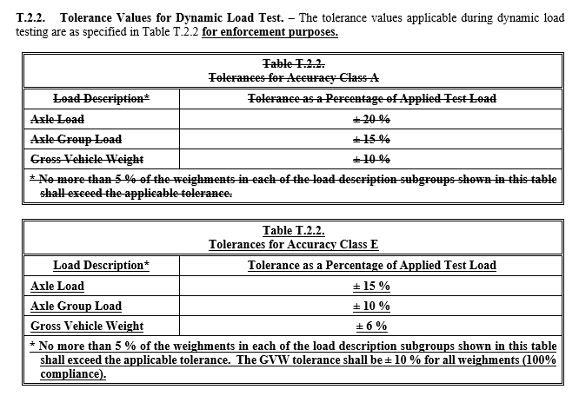
Tolerances
Tightened versus tentative screening codes
3 speeds, including posted speed limit
Different vehicle types
Different loads
95% compliance, with 100% within upper limit
Rigorous test to ensure capability and fairness

Slide 13
Temperature
S.5 Mark operational temperature limits
T.3.1 Must meet in all conditions or manufacture must specify limited range
Data collected at different times of the year from States with varying weather conditions

Slide 14
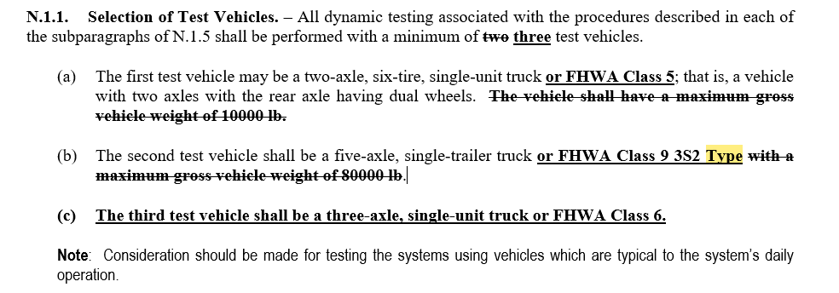
Truck Configurations
Different body types
Most common truck traffic
Note to consider other vehicles common to the site

Slide 15
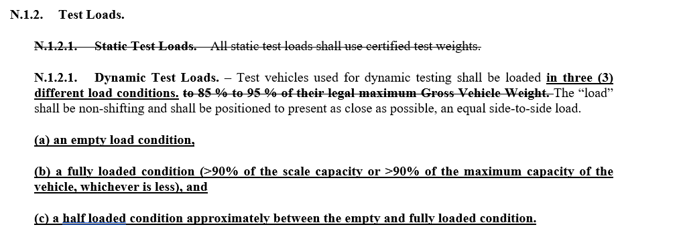
Loads
non-shifting – loads would be excluded from automated weight enforcement
3 load conditions like single draft weighing

Slide 16
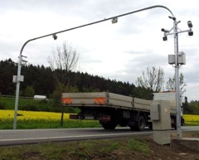
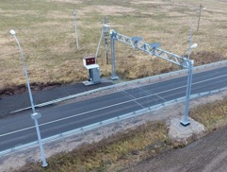
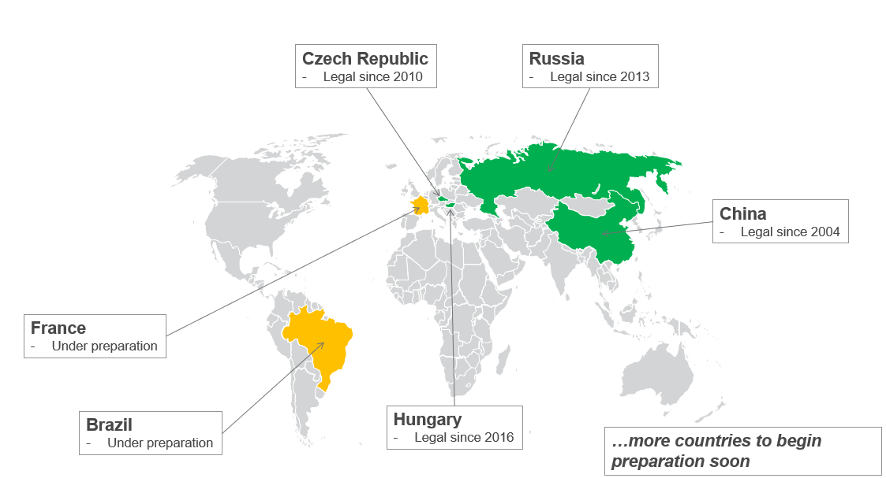
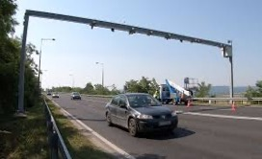
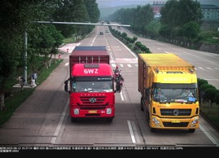
Direct Enforcement in Foreign Countries
Country | Legal/ Operation | Standards used | Accuracy GVW
Czech Republic | 2010 / 2015 | Local standard w/ ASTM E1318, OIML R‐134 and COST 323 | ±5%
Hungary | 2016 / 2018 | Local standard w/ OIML R‐134 | ±5%
Russia | 2013 / 2015 | Federal Standard | ±2% (static) ±5% (20+ km/h)
China | 2004 / 2016 | Local standard w/ OIML R134 | ±5% (2-axle) ±10% (Others)
Protect Infrastructure Assets/Efficient Enforcement

